Slide 1
Why LLMs?
PREMALATHA T

Slide 2
LLM
The advent of large language models like GPT-4 has transformed the landscape of artificialintelligence.
But why are these expansive models so significant?

Slide 3
Improved Accuracy
As models grow in size, they tend to perform better on a wide array of tasks.
Their vast amount of parameters allow them to capture more intricate patterns in the data, leading to more accurate results, especially in complex tasks like translation, text generation, and more.

Slide 4
Extensive Knowledge Base
Large models are trained on vast amounts of data, making them a repository of wide ranging information.
As a result, they can respond to a plethora of queries, from scientific concepts to pop culture references.

Slide 5
Generalization Across Tasks
Unlike smaller, task-specific models, large models like GPT-4 can generalize across a multitude of tasks without task-specific training.
This makes them versatile tools that can be fine-tuned for specific applications or used 'out-of-the-box'.

Slide 6
Generalization Across Tasks
Unlike smaller, task-specific models, large models like GPT-4 can generalize across a multitude of tasks without task-specific training.
This makes them versatile tools that can be fine-tuned for specific applications or used 'out-of-the-box'.

Slide 7
Reduced Need for Task-Specific Models
Before the rise of large models, developers often needed a specific model for each task.
With the capabilities of large models, this is no longer always necessary.
A single model can serve multiple purposes, simplifying the development process.

Slide 8
Cost Efficiency in the Long Run
Though training large models requires substantial resources, their versatility can lead to cost savings in the long run.
Instead of investing in multiple models for various tasks, organizations can invest in a single, robust model that caters to various needs.

Slide 9
Enhanced Creativity and Fluidity
Large models are better at generating human-like text.
Their responses are often more fluid, nuanced, and creative, making them ideal for tasks that require a touch of human essence, like content generation, poetry writing, etc.

Slide 10
Continual Learning and Adaptation
These models have a remarkable ability to adapt and learn from new data.
This makes them suitable for evolving tasks and changing environments

Slide 11
Richer Context Understanding
Due to their size and design, large models can hold extensive context, allowing them to provide more relevant and contextually aware answers or suggestions.

Slide 12
Multilingual Capabilities
Many of the latest large models are trained on data from various languages, making them capable of understanding and generating content in multiple languages, often without the need for translation models

Slide 13
Few-shot Learning
Large models exhibit the capability of learning with minimal labeled data, often referred to as few-shot learning.
This reduces the reliance on extensive labeled datasets for training

Slide 14
Challenges & Considerations
While there are numerous advantages, it's essential to acknowledge the challenges associated with large language models:
Resource Intensive Training these models requires massive computational resources and energy.
Potential for Biases:Since they are trained on vast and varied datasets, there's a risk of them inheriting and perpetuating biases present in the data.

Slide 15
Continued-
Complexity in Deployment
Their size can make them challenging to deploy in resource-constrained environments.
Overfitting
There's a risk of the model overfitting to its training data, especially if not managed properly.

Slide 16
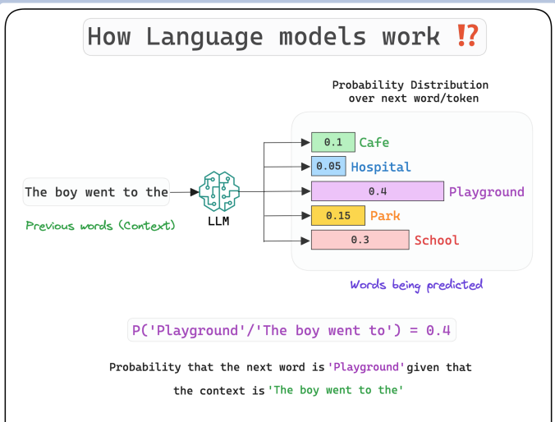

Slide 17
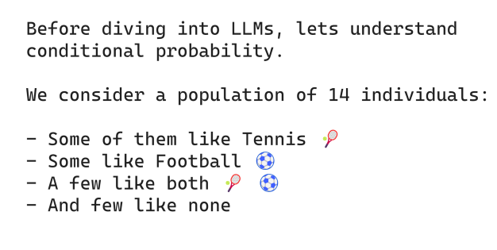

Slide 18
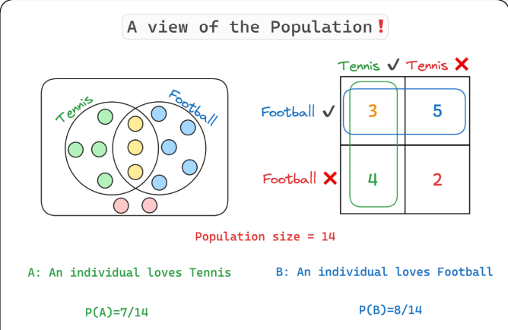

Slide 19
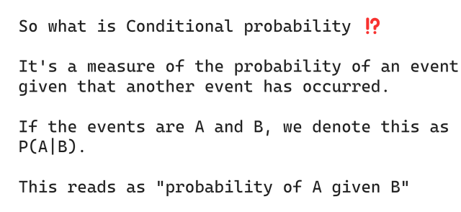

Slide 20
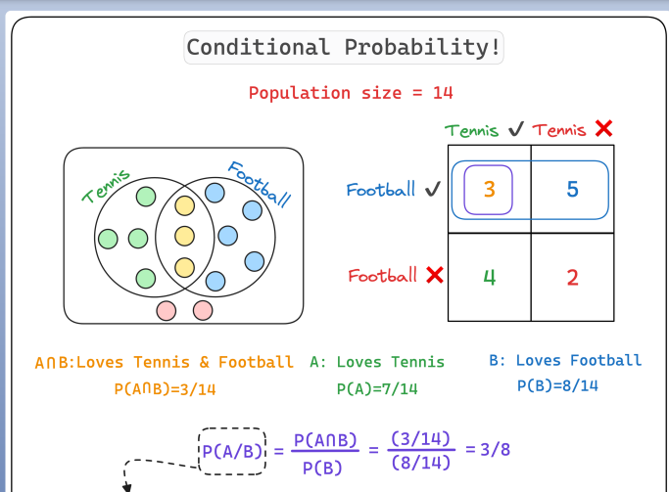

Slide 21
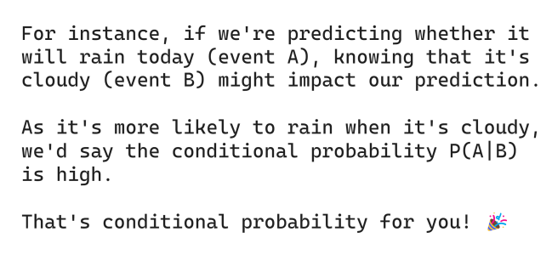

Slide 22
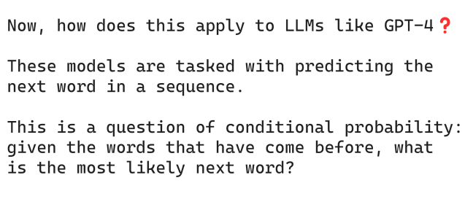

Slide 23
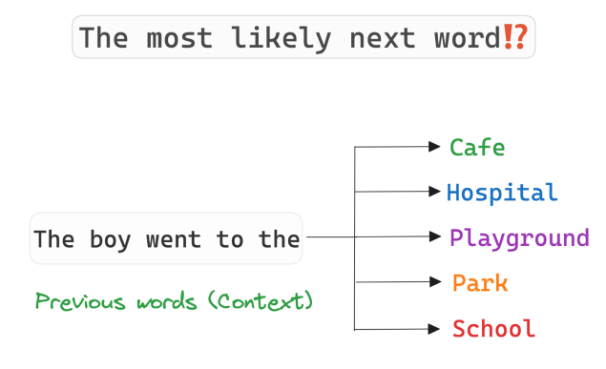

Slide 24
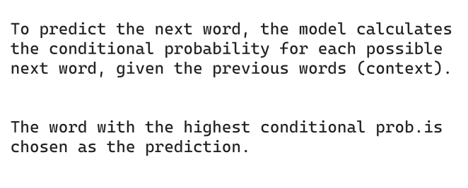

Slide 25
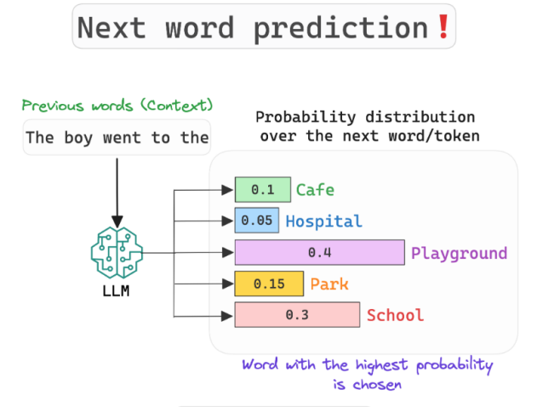

Slide 26
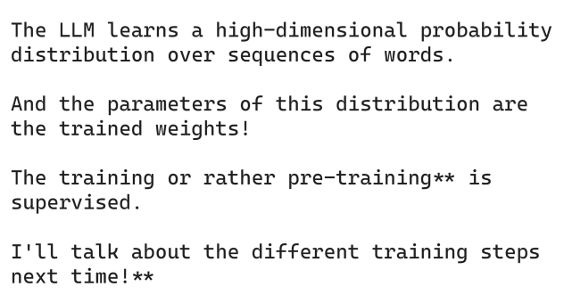

Slide 27
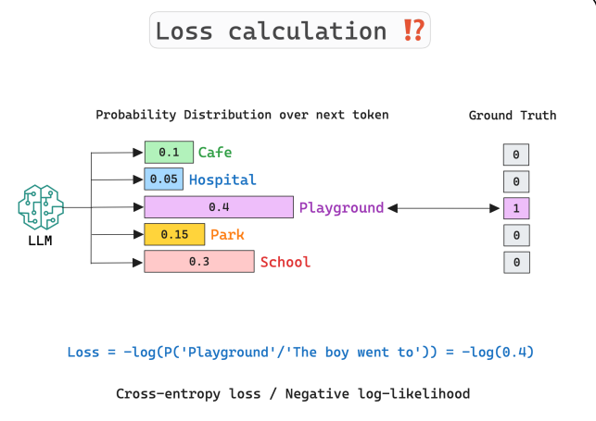

Slide 28
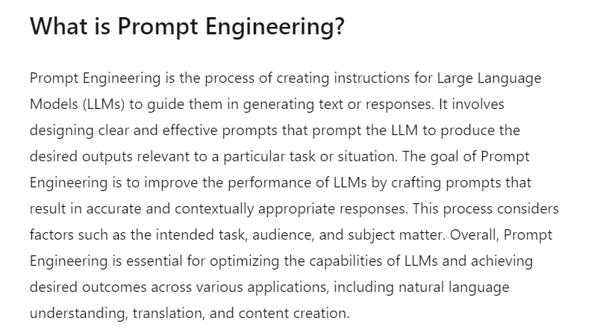

Slide 29
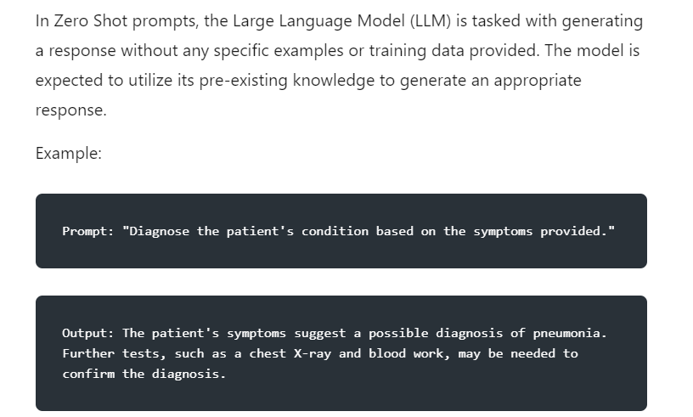

Slide 30
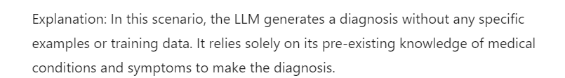

Slide 31
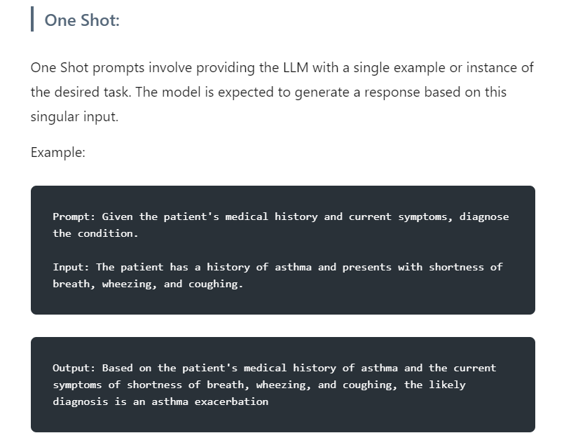

Slide 32
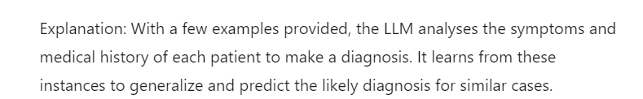

Slide 33


Slide 34
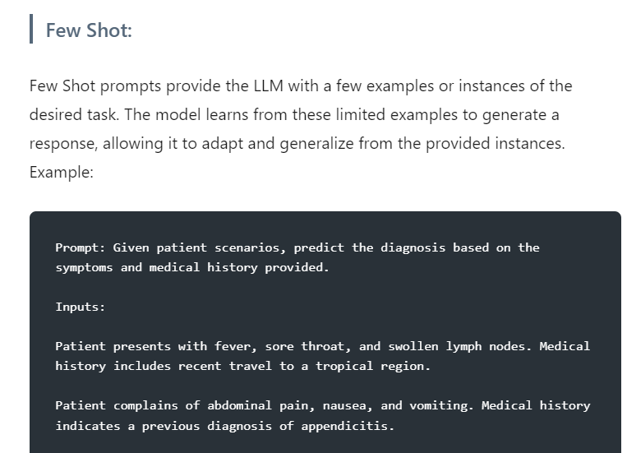

Slide 35
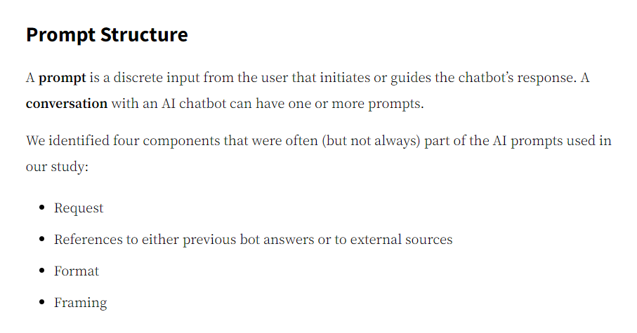

Slide 36
